Slide 1
Clash Royale Deck & Archetypes Analysis
Datathon 2025
Team: Pandas Powerhouse
Paolo Halog, Lily Heinonen, David Kaufman, Bishista Paul, Michelle Reyes

Slide 2
Table of contents
01
03
02
04
Initial Analysis
Model Findings / Analysis
Archetype Analysis
Summary & Takeaway

Slide 3
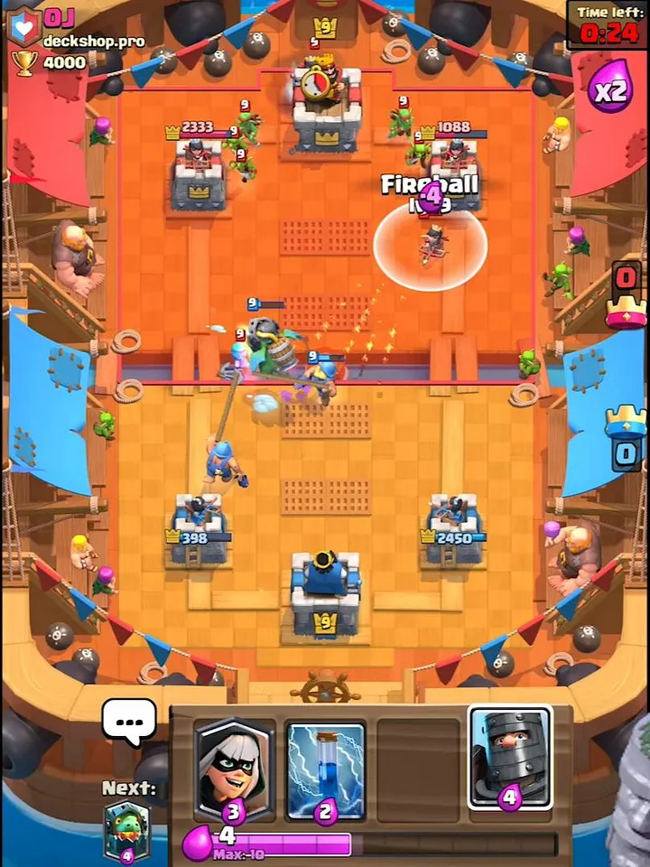
General Gameplay
Gameplay
3 minute strategy game where two players compete to destroy each other’s towers
Each player has a deck of 8 cards, consisting of troops, spells, elixir and towers (e.g. Mortar, X-Bow, and Inferno Tower)
Each player’s territory is connected by two bridges

Slide 4

01
Initial Analysis
What we Saw, Cleaned, and Questioned

Slide 5


Initial Analysis
Content
Size/Shape

Slide 6
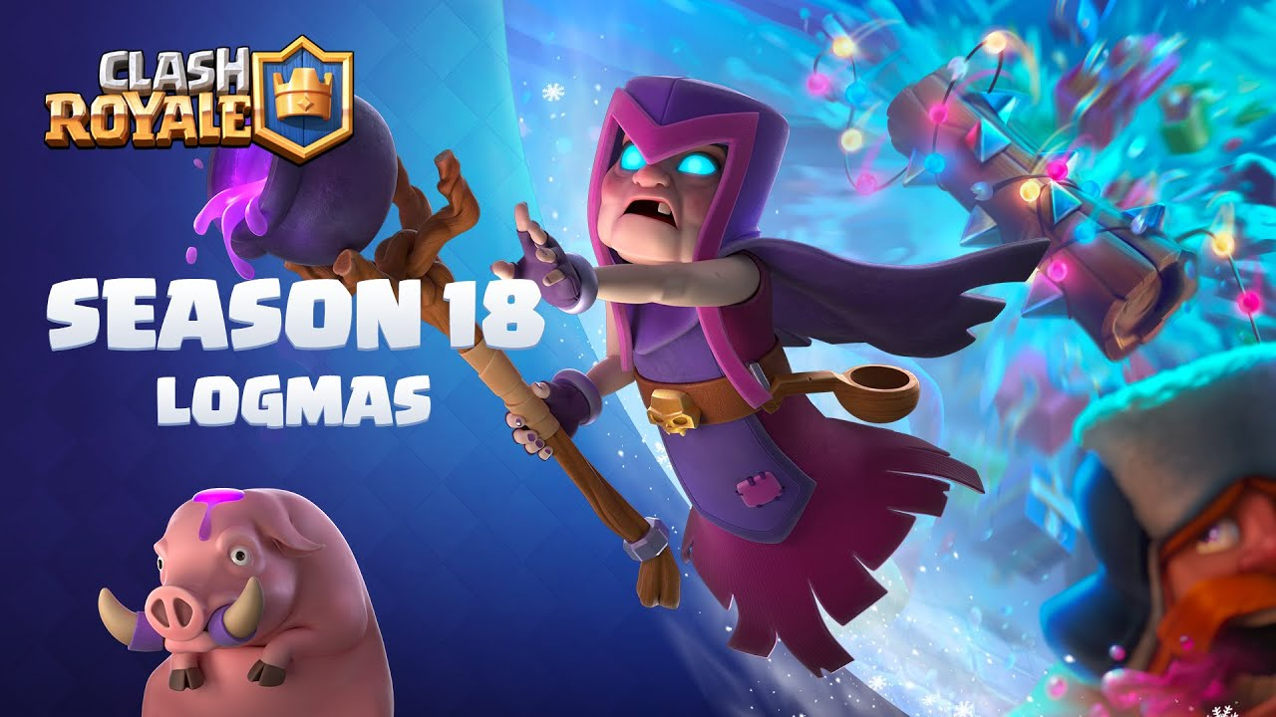
Content
Time
Relevancy
December 2020: 7-11 AND 14-18
Weekdays ONLY
24 Hour Periods
Season 18, LOGMAS
Winter Event
(Mother Witch)

Slide 7
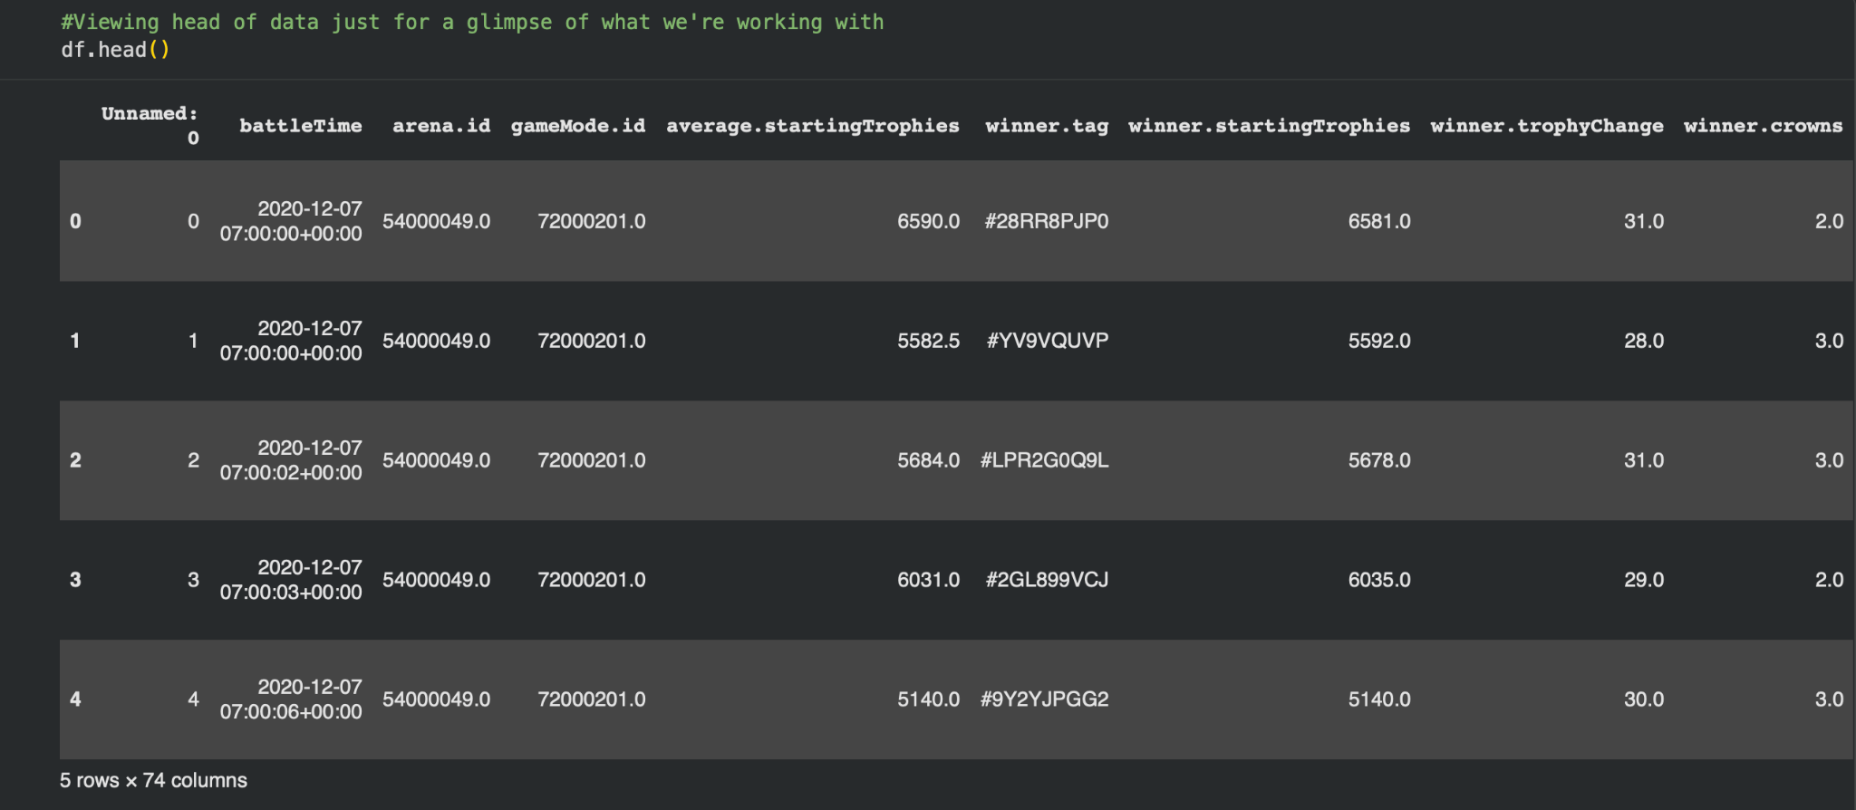
Size/Shape
Snippet of data
5 out of 16.8 MILLION Rows
&
74 Columns

Slide 8
Initial Question
How do different card combinations and cards selected affect the outcome of a match?

Slide 9
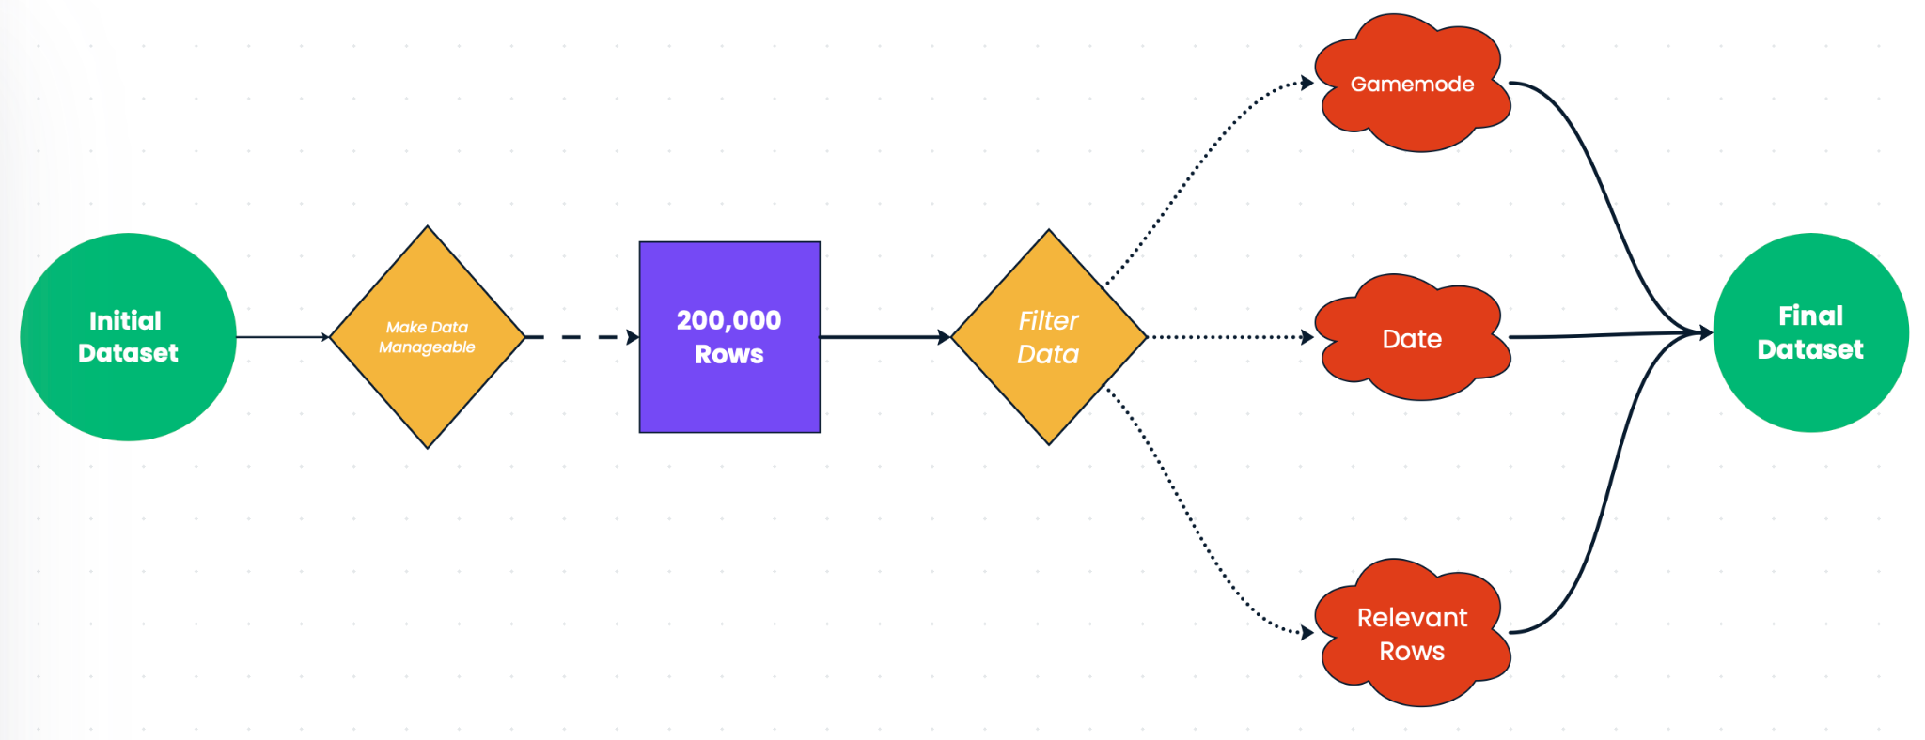
Cleaning the Dataset
16.8 mil x 74
47,881 x 61
Notes:
Gamemode: we decided on the most commonly used game mode to help reduce values
Date: we decided to pick a single date (12/9); optimal date out of all weekdays
Relevant Rows: deleting and choosing rows based off of our question and we included columns such as winner/loser cards, their respective level, and each decks respective average elixir

Slide 10
02
Archetype Analysis

Slide 11
What is an archetype?
A strategy for building a deck that aims to win a match
In Clash Royale, there are multiple deck building style or strategy with a distinct playstyle
The deck types are:
Beatdown (Heavy elixir decks with powerful cards; e.g. tank)
Bait (Low-elixir decks designed to provoke opponent’s counter cards)
Control (Balanced defense decks)
Cycle (Fast recycling low-elixir decks)
Siege (Long-range damage decks)
Bridgespam (Aggressive deck pressure at the bridge)

Slide 12
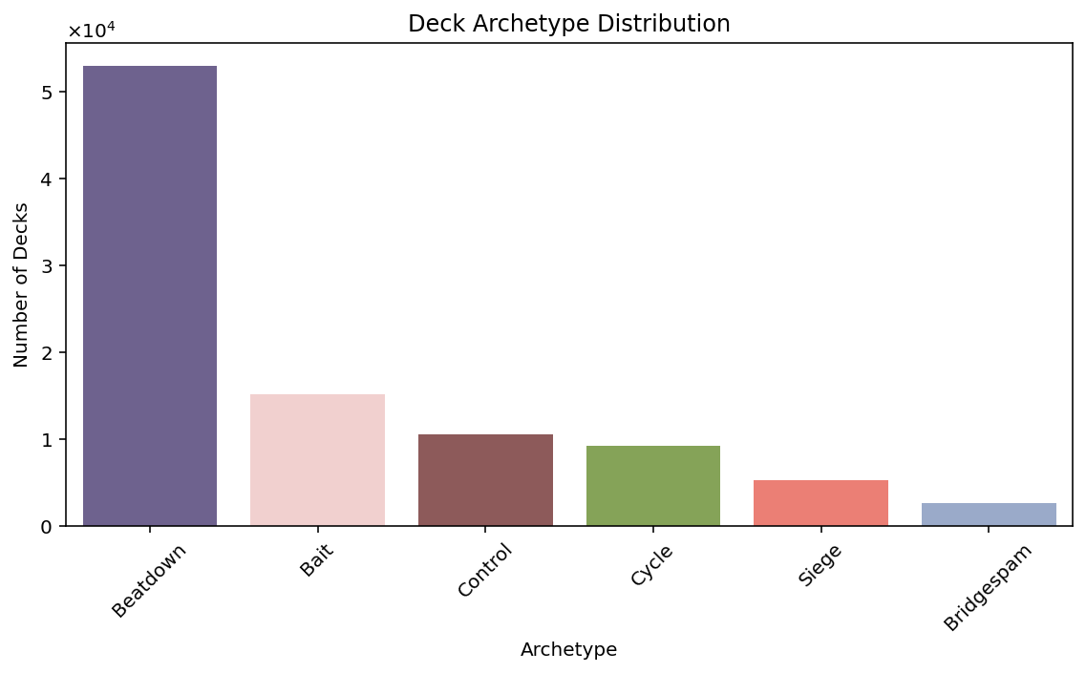

Slide 13
Archetype Distribution
Archetype | Total Decks | Percentages
Beatdown | 53,017 | 55.36 %
Bait | 15,131 | 15.80 %
Control | 10,518 | 10.98 %
Cycle | 9,183 | 9.59 %
Siege | 5,305 | 5.54 %
Bridgespam | 2,608 | 2.72 %

Slide 14
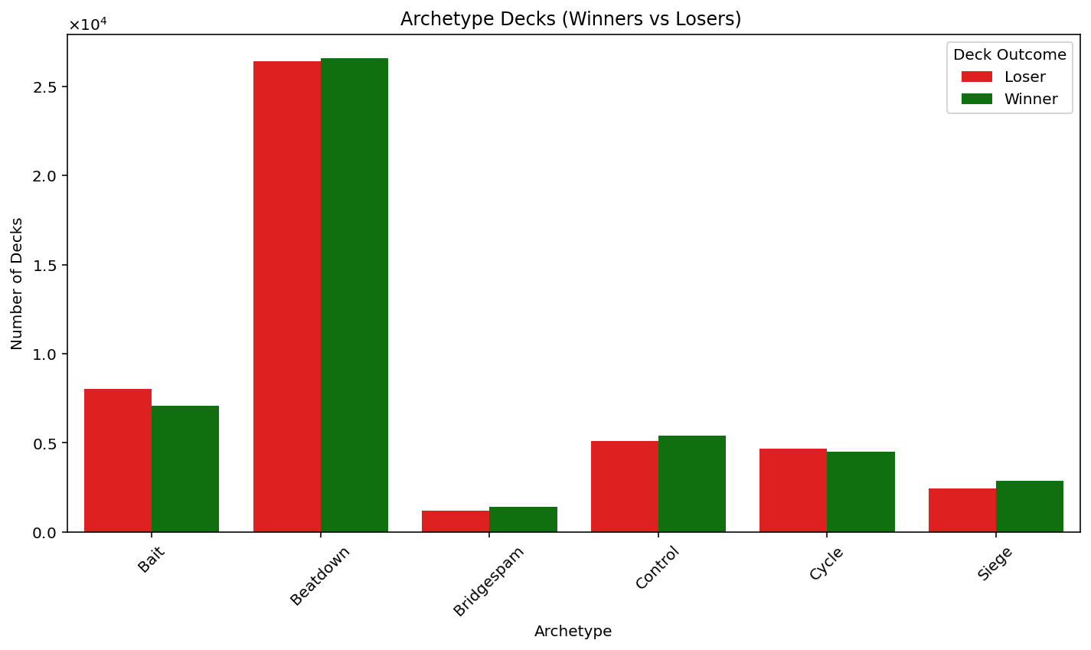

Slide 15
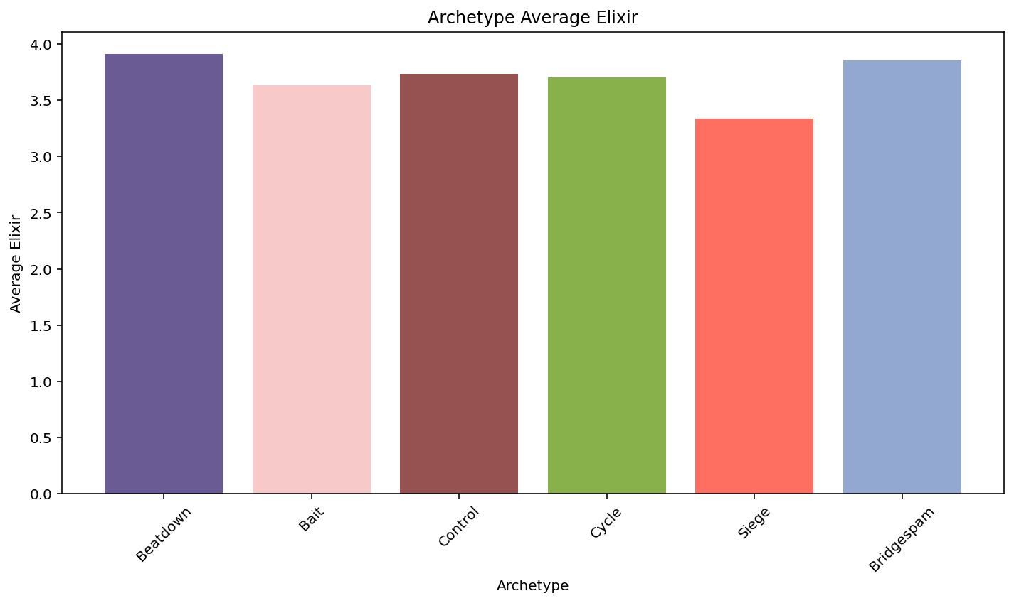
Archetype Elixir Usage
Archetype | Average Elixir
Beatdown | 3.91
Bait | 3.64
Control | 3.74
Cycle | 3.71
Siege | 3.34
Bridgespam | 3.86

Slide 16
Archetype Elixir Summary Statistics
Archetype | Count | Mean | STD | Min | 1Q | Median | 3Q | Max
Bait | 15,131 | 3.64 | 0.45 | 2.13 | 3.25 | 3.63 | 4.00 | 5.25
Beatdown | 53,017 | 3.91 | 0.51 | 1.50 | 3.63 | 3.88 | 4.25 | 7.50
Bridgespam | 2,608 | 3.56 | 0.45 | 2.38 | 3.50 | 3.88 | 4.13 | 5.50
Control | 10,518 | 3.74 | 0.56 | 1.50 | 3.34 | 3.75 | 4.13 | 6.13
Cycle | 9,183 | 3.71 | 0.46 | 1.84 | 3.34 | 3.75 | 4.00 | 6.00
Siege | 5,305 | 3.34 | 0.45 | 2.50 | 3.00 | 3.13 | 3.50 | 6.63

Slide 17
03
Model Findings / Analysis

Slide 18
IQ: How do different card combinations and cards selected affect the outcome of a match?
Our goal is to identify the key factors that contribute to a player's success in Clash Royale. We hypothesize:
the number of cards within each category (troops, spells, and buildings) + the average elixir cost of the deck
composition of the deck + and the player's starting trophy count.
We developed two XGBoost models to evaluate our hypotheses, aiming to predict a player's likelihood of winning based on the combinations or structure of the deck.

Slide 19
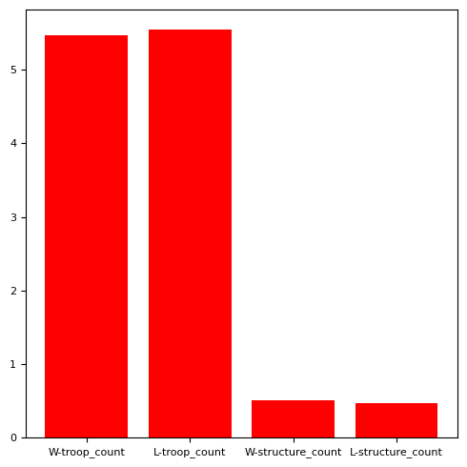
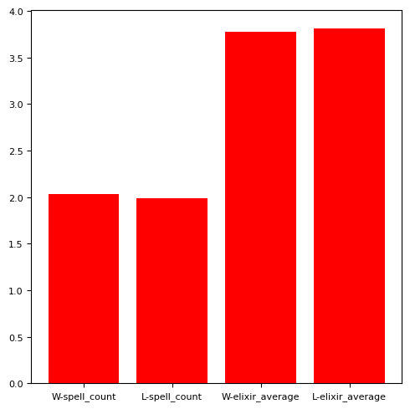
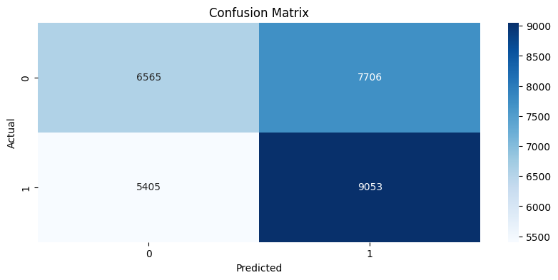
In the first xgboost model, the accuracy of this model is 54.232%. Essentially, it is like a coin-toss.
the number of cards within each category (troops, spells, and buildings) + the average elixir cost of the deck
Analysis
Both winner and non-winner have the similar statistics in the counts between categories: spell, count, troops.

Slide 20
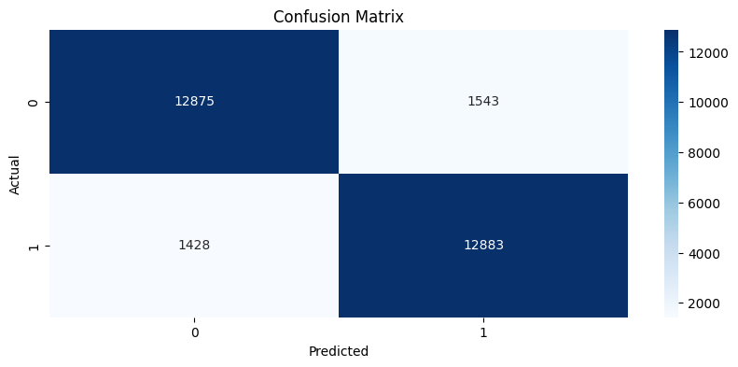
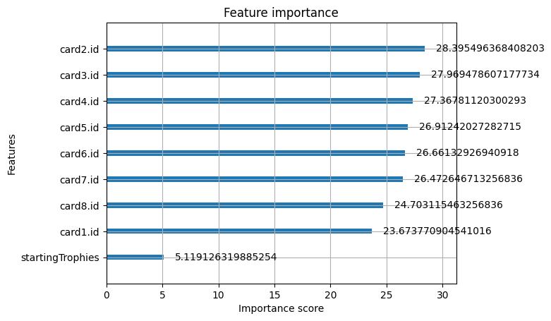
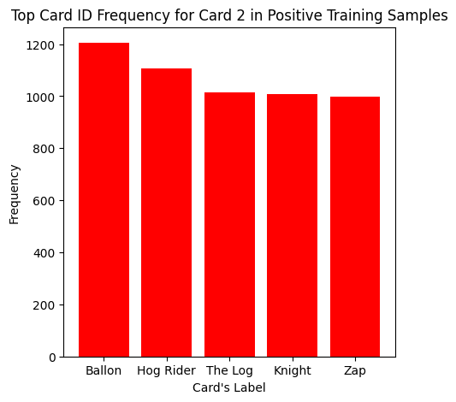
Analysis:
All 8 cards are chosen by the player, often selected based on experience of the game beforehand.
This model suggests that the most defining card to the game is the second card.
However, the remaining selection of the cards afterwards still matter to a player’s winner.
Strategy + Experience→ predictive of success than the deck alone.
In the second xgboost model, the accuracy of this model is 89.227%
Based on the deck + starting trophies.

Slide 21
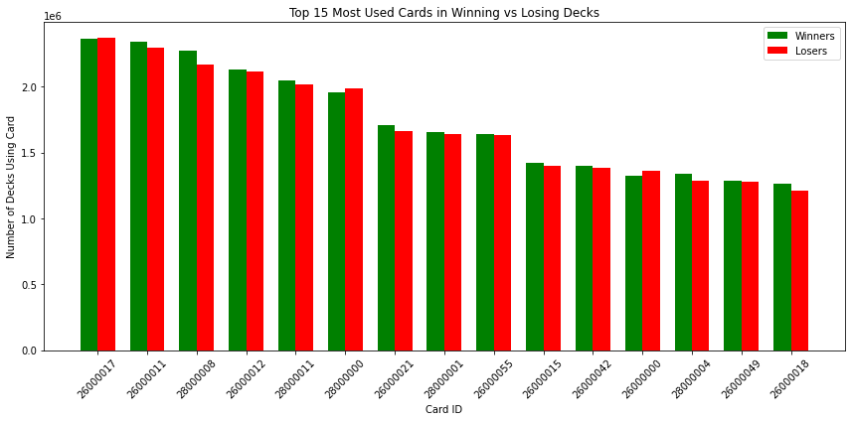
Wizard
Valkyrie
Zap
Skeleton Army
The Log
Cannon
Hog Rider
Arrows
Mega Knight
Baby Dragon
Electro Wizard
Knight
Goblin Barrel
Bats
Mini PEKKA
Card

Slide 22
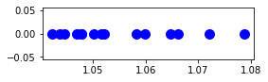
Odds Ratio
 | With Card | Without Card
Winner | Winner With Card | Winner Without Card
Loser | Loser With Card | Loser Without Card
How does having a specific card affect the odds of winning or losing?
Notes:
Determine how strongly winning and losing are associated with a given card. A value of 1 means they’re not associated, or that given a specific card, winning and losing are the exact same. A value less than 1 means that card is more associated with losing and a value above 1 means that card is more associated with winning.

Slide 23
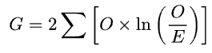
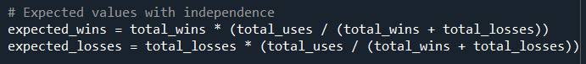
G Squared Test
How do our observed values and expected values differ?
Null: They do not differ.
Alternative: They do differ.
Notes:
G squared test is a log likelihood ratio test. In this test, I used it to determine whether the winning and losing decks model what is expected or not. In our null hypothesis, losing and winning given a card is the exact same and our alternative is that they are different.

Slide 24
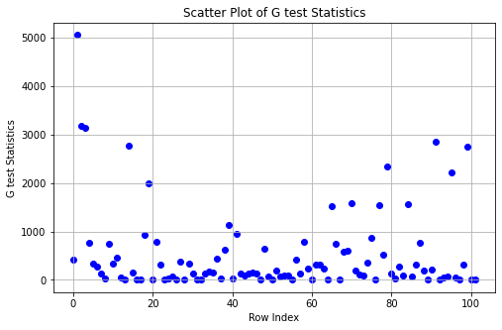
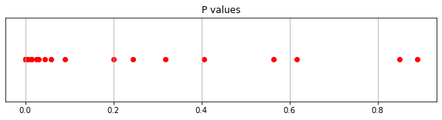
Notes:
The vast majority(~90%) of the values are extremely small and show that winning and losing given a card is not the exact same.

Slide 25
04
Summary / Takeaway

Slide 26
Conclusion
We were able to create a successful model that determines whether a deck will win or lose given cards and their levels.
Limitations:
Lack of application to current gameplay
Card mechanics
Game mechanics
It also seems that cards and levels are not the only factor that determine a win or loss
Experience
Strategy

Slide 27
Thank You

Slide 28
Sources
social, alter ego. “All 6 Deck Types in Clash Royale.” YouTube, YouTube, 15 Oct. 2025, www.youtube.com/shorts/ bPjRQsIZSMI.
Wando, Bwando. “Clash Royale S18 Ladder Datasets (37.9m Matches).” Kaggle, 28 Nov. 2024, www.kaggle.com/ datasets/bwandowando/clash-royale-season-18-dec-0320-dataset.
Wiki, Contributors to Clash Royale. “Basics of Battle.” Clash Royale Wiki, Fandom, Inc., clashroyale.fandom.com/ wiki/Basics_of_Battle. Accessed 13 Nov. 2025.
Witt, Jeff. “A Tale of Two Games: How Clash Royale and AFK Arena Handled Their Monetization Differently.” Medium, ggDigest.com, 25 Feb. 2021, medium.com/ggdigest/a-tale-of-two-games-how-clash-royale-and-afk-arena -handled-their-monetization-differently-8f58a05d9985.
Github: https://github.com/CyberVison24/Datathon-Fall-2025.git

